Slide 1
Lessons from a Master´s Thesis: Norwegian Policies concerning Tax Havens with regard to Tax Matters, 1970-2012. ”A Narrative of political Powerlessness”
A historical approach
Kristine Sævold, UiB/CMI
The Capitalflight Conference, 16th of November 2012

Slide 2
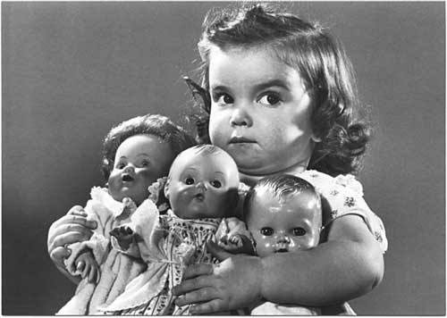
Overarching research interest:
Poverty-production:
What has the rich to do with poverty?

Slide 3
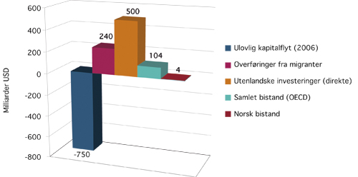
Causes of Poverty: Tax Havens´ role
Source: Kar/Cartwright-Smith (2008)

Slide 4
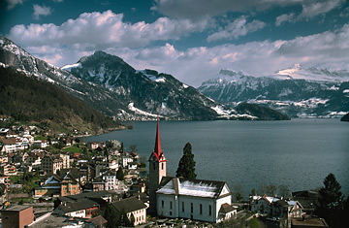
What is a Tax Haven?
IRS
The power of definition (OECD 1998):
a) No or only nominal taxes
In combination with at least one other criteria:
b) Lack of effective exchange of information
c) Lack of transparency
d) No substantial activities/ ”ring- fencing” (“postboxes”)
Secrecy jurisdictions +
low tax jurisdictions (2/3 tax level)
IMF
FSISI

Slide 5
Tax Havens – a Systemic Problem
- Poverty + human trafficking, weapons smuggling, corruption, environmental crime, tax evasion and avoidance, financial crisis, terrorism, inequality, undermining of Parliamentary decisions, violation of 200 year old tax sharing principles among countries and ”social dumping”….
- The international community -> failed. Why?

Slide 6
A common Business Practice

Slide 7
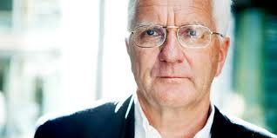
A Business-Community in Denial
Finansavisen, editorial page 12th of October
Ok – We invest over Tax Havens – What´s the problem??

Slide 8
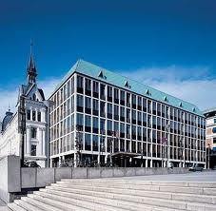
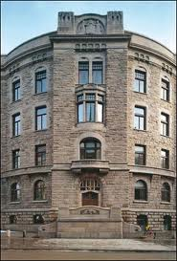
A “Clash” of Ministeries
An international Convention on Transparency!
Great!!
LOL!!OECD!

Slide 9
“Economic Competition”
3 OECD-member interest groups – “a collective action” problem:
Countries fearing fiscal degradation ( but don´t touch our shipping-regimes!)
Low tax jurisdictions - look to banking secrecy!
Banking secrecy jurisdictions - look to low-tax regimes!
Non-members - look to your own members!

Slide 10
The USA - The Webmaster
Democratic rule 1980: Progress
Republican rule 1981-1993: Setback
Democratic rule 1996-2000: Progress
Republican rule 2001-2008: Setback
Democratic rule 2008 - : Progress
Democratic rule 2012-2016 Progress..?
A sum up: A narrative of political powerlessness

Slide 11
Competing paradigms
There are other solutions!

Slide 12
The MF in Tax Havens
The NPFG is a pure ECONOMIC actor!
Is that true?
Kristine Sævold (2016)?

Slide 13
The “Take-Away” for further studies
Poverty, human trafficking, weapons smuggling, corruption, environmental crime, tax evasion and avoidance, financial crisis, terrorism, inequality, undermining of parliamentary decisions, violation of 200 year old tax sharing principles among countries and ”social dumping”….
X
Secrecy laws + low tax regimes

